Slide 1
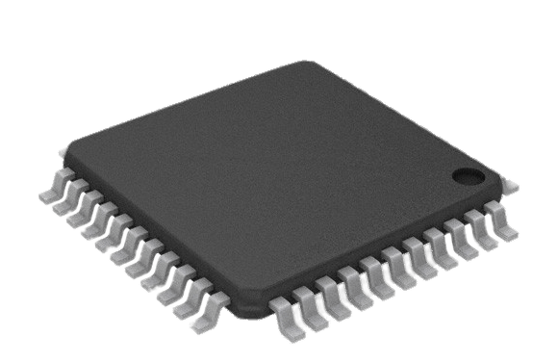
Digital ASIC Design Industry Panel Presentation
[1]
Gregory Ling
Will Galles
Jake Hafele
Cade Breeding
Class: CPR E 492
Group: sddec23-06
Client/Advisor: Dr. Duwe
Website: http://sddec23-06.sd.ece.iastate.edu/
Notes:
Web link in chat

Slide 2
Introduction
Problem Statement
Solution
Requirements
Users
Market Survey
Gregory Ling

Slide 3
Problem Statement
Introduction
The ability to create a custom digital ASIC (Application Specific Integrated Circuit) is often locked behind high barriers to entry and traditionally restricted to teams of industry professionals.
p. 16
Notes:
PAGE NUMBERS,
eFabless has provided a free fabrication option named OpenMPW with the requirement that all submissions be open-source, and we will test their manufacturing process and determine its limits. What we learn will be passed down to future users who will use our design as a reference in creating their own for research or other learning tasks.

Slide 4
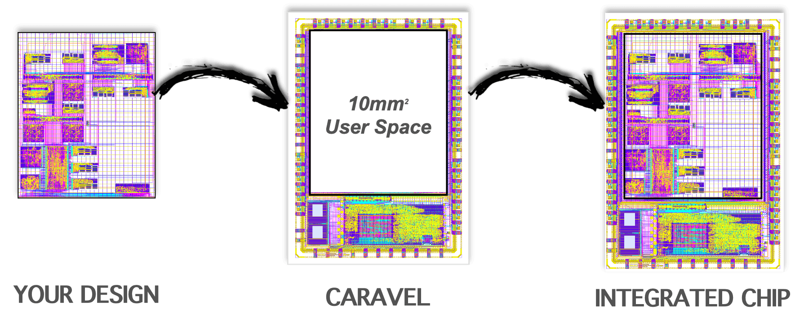
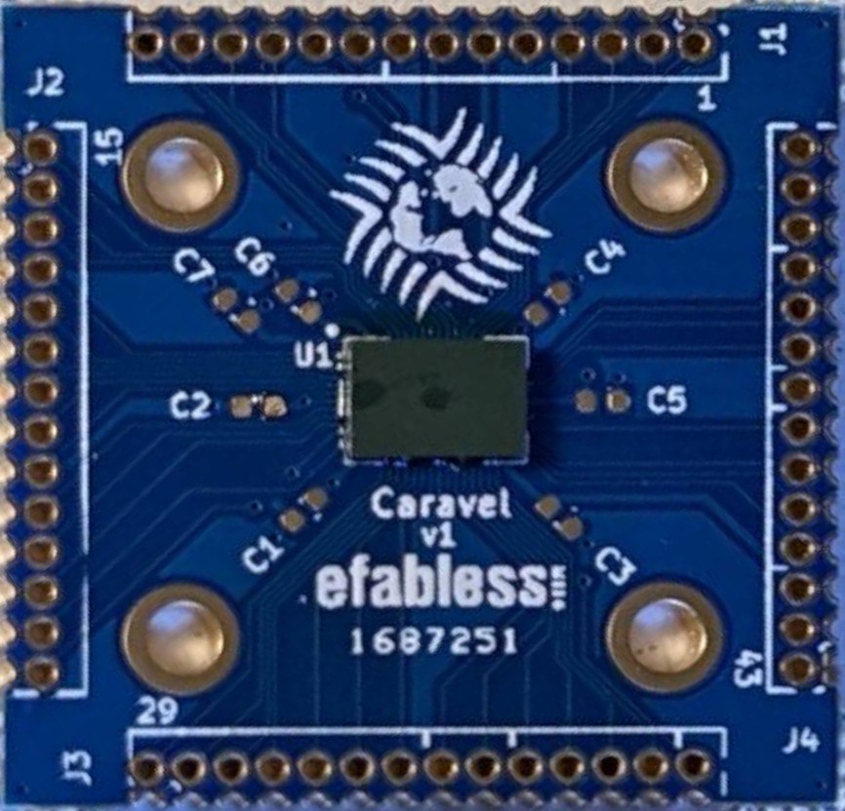
OpenMPW
Introduction
[2]
Multi-Project Wafer
Skywater 130nm PDK
OpenROAD
Yosys
Klayout
Magic
XSchem
[3]
p. 16-18
Notes:
Emphasize lack of institutional knowledge at ISU in transition
eFabless has provided a free fabrication option named OpenMPW with the requirement that all submissions be open-source, and we will test their manufacturing process and determine its limits. What we learn will be passed down to future users who will use our design as a reference in creating their own for research or other learning tasks.
10 mm2 user area
SkyWater 130 nm fabrication process
Verilog
Open-source repository

Slide 5
Goals
Introduction
Explore
Modular design to test different limits of the fabrication process
Learn
Expand the knowledge base of open-source fabrication at ISU
Bring-Up Plan
Create a plan for a future group to bring-up our fabricated design
p. 16

Slide 6
Users
Introduction
Our Team
Research
Groups
Future Teams
Open Source
Community
p. 19

Slide 7
Market Survey and Cost Estimate
Introduction
Production Run
~$1M for full ASIC
Multi-Project Wafer
OpenMPW – eFabless, open-source, funded by Google
ChipIgnite – eFabless, paid ($9,750/project, 10mm², 4-5 months)
Muse Semiconductor – TSMC, paid ($1,250/mm², 42 days)
Our Cost
All design tools are open source
Only real cost of the project is our time
p. 20
Notes:
Muse lacks tool support

Slide 8
Design
Design Requirements
Top Level Design
Module Descriptions
Will Galles

Slide 9
Technical Design Requirements
Design
Create a modular design that would allow for a wide array of operations to take place
Create a redundant system that would still be able to operate if there was a manufacturing failure
Explore new technologies and processes that had not been explored by previous teams
p. 16-18
Notes:
Explain that these are very high level point directly to page number assessing them
Open MPW have their own set of submission requirements mention here and explain later

Slide 10
Wishbone Test Module
Design
Purpose
Test on chip communication buses
p. 85
Notes:
The first module in our design is the wishbone test module. It is a module that was created to test the functionality of our primary data in the chip the wishbone bus. As shown here the wishbone bus provides a data bus connection between the test module and the onboard management microcontroller. The module provides this functionality by providing a location where wishbone messages can be reliably written and read from.
The primary purpose for this module is to solidify how to implement and use the wishbone bus.
Wishbone Test
Counter increments every cycle
Read and write via Wishbone bus or backdoor SPI to verify functionality of communication paths
Revealed a bug in the provided management wrapper

Slide 11
DSP Accelerator Module
Design
Purpose
Utilize OpenRAM generated SRAM
Implement a more complex design
pp. 81-83
Notes:
The next module in our design is the Digital Signal Processing accelerator. This module was created to act as a convolutional accelerator for a real time Road Noise Suppression Application. The module is connected to the wishbone bus same as the previous test module. It uses this connection to take in data to store in its integrated memory to be used in the convolution. It also contains a MAC unit that preforms actual convolution and generates the final output. From there the DSP module uses its interrupt connection to the management micro controller to let it know that it has completed the convolution.
In our design analysis we determined that in order to meet the 8kHz sampling rate needed for human voice we would need a clock speed of 8.2 MHz to be able to run in real time.
The main purpose of this module to expand our knowledge of implementing and using the OpenRam generated sram.
Talk about DSP Metrics
DSP
Implements a Convolution accelerator
Data bus connections to wishbone and spi bus to load in data
Interfaces with the two memories that store weights and data values
Mac unit to perform the convolution

Slide 12
Backdoor SPI Module
Design
Purpose
Backup data bus in case of failure
Test crossing clock domains
pp. 80-81
Notes:
The third module in our design is the Backdoor SPI module. This module creates an external SPI connection using the IO ports on the chip. It provides a secondary communication bus in the case that the wishbone bus fails. The module is designed to transfer data across clock domains and synchronize to the internal clock. The internal SPI bus that this module provides has connections to both the wishbone test and DSP modules.
The main purpose of this module was to create a backup data bus within the chip and to test bringing in external data across clock domains.
BackDoor SPI
External SPI interface through IO ports
Extra communication bus if wishbone bus fails
Communicates with wishbone test and DSP accelerator
Handles clock synchronization between SPI Master and Wishbone clocks
Uses 2 DFF's for control signals as buffer

Slide 13
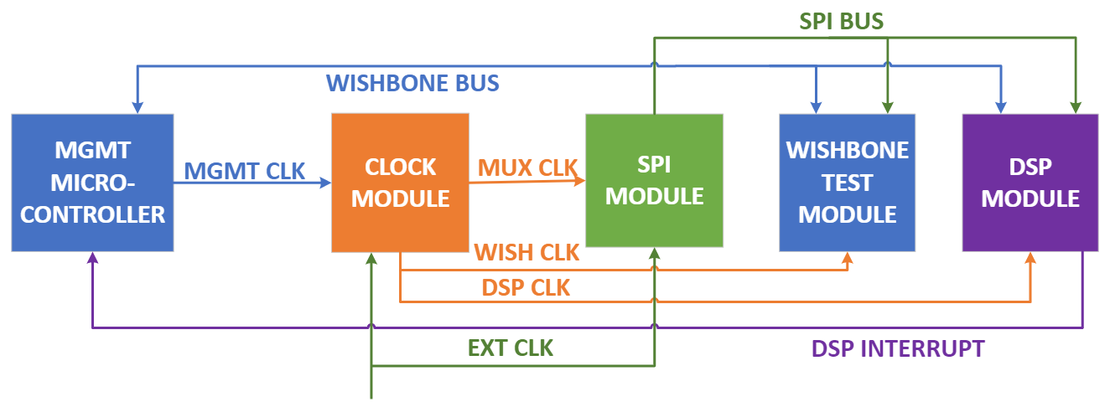
Clock Module
Design
Purpose
Test multiple clock domains
Backup clock in case of failure
p. 83-84
Notes:
The next module in our design is our Clock module. It is responsible for managing the clock signal running the functional modules in our design. The module implements a clock mux that allows for the internal clock to switch between the management clock provided by the management microcontroller and an external clock brought in by the IO pins. The module also implements clock gating that can be used to turn of individual modules.
The main purpose of this module was to test multiple clocks originating from within and outside the chip along with clock gating individual modules.
Clock Multiplexer
Gating to enable/disable the clock to the user project
Multiplexing to switch between the provided internal clock and an external clock for each clocked module

Slide 14
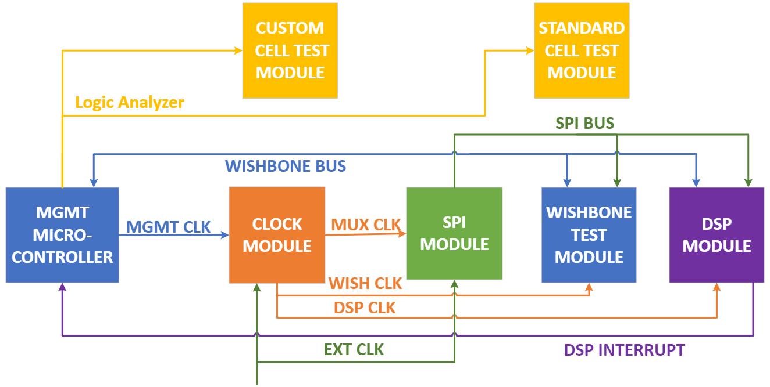
Standard Cell & Custom Cell
Design
Purpose
Verify base PDK functionality
Perform manual digital layout
p. 84
Notes:
The last two modules in our design are the Standard Cell Test and the Custom Cell test. The standard cell test is just an implementation of a singe cell from the Skywater PDK. It provides a basic test of the PDK’s standard cells’ functionality. The custom cell test is a manually created implementation of a NAND gate. It was created by hand using XSchem and Magic to layout and design the individual metal layers.
The main purpose of these modules are to verify the functionality of the Skywater PDK and to design and implement a custom digital cell.
Standard Cell
Simple AND gate from the standard cell library to provide a baseline test
Custom Cell
NAND gate created manually in XSchem and Magic to try creating a fully custom cell

Slide 15
Test Overview
Platforms Used
Test Plan
Jake Hafele
Notes:
Platforms Used
Test Plan
Testing Thus Far

Slide 16
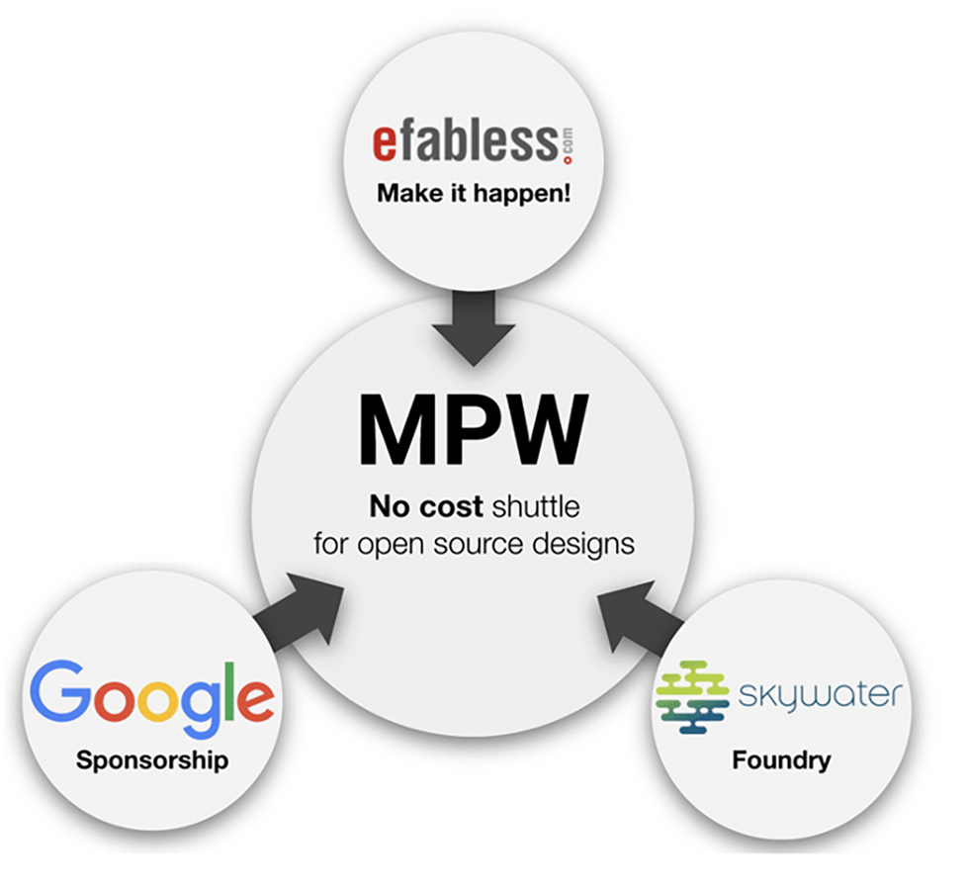
Platforms Used
Test Overview
OpenROAD
RTL synthesis through GDS Layout
Magic
Custom cell layout
KLayout
Layout viewer
GTKWave
Waveform viewer
[4]
p. 25-56
Notes:
As gregory mentioned before, there are no financial costs for our project.
Open Source Tools:
OpenROAD
Used for module hardening and system integration
Uses RTL design and SkyWater 130 nm Product Development Kit to generate GDSII netlist
Standard cell process for layout
Place and route
Magic
VLSI Layout tool
Used for custom cell layout
KLayout
Layout viewer from OpenROAD generation
GTKWave
View RTL and GL waveform outputs
Used for unit testing and system integration

Slide 17
Test Plan
Test Overview
Unit/Regression Testing
Integration Testing
RTL Simulations
Gate Level
Simulations
C Firmware
Simulations
Interface Testing
Bring-Up Plan
Acceptance Testing
Firmware Testing
Document Test Plan
SDF Simulations
MPW Precheck
pp. 36-39
Notes:
Signoff
Meet above 8MHz for DSP to meet real time constraints
SDF Simulations
Can also point out precheck requirements - Unique design/README
XOR check between KLayout and Magic
DRC check

Slide 18
Implementation
Behavioral RTL
Custom Cells
SRAM
Jake Hafele

Slide 19
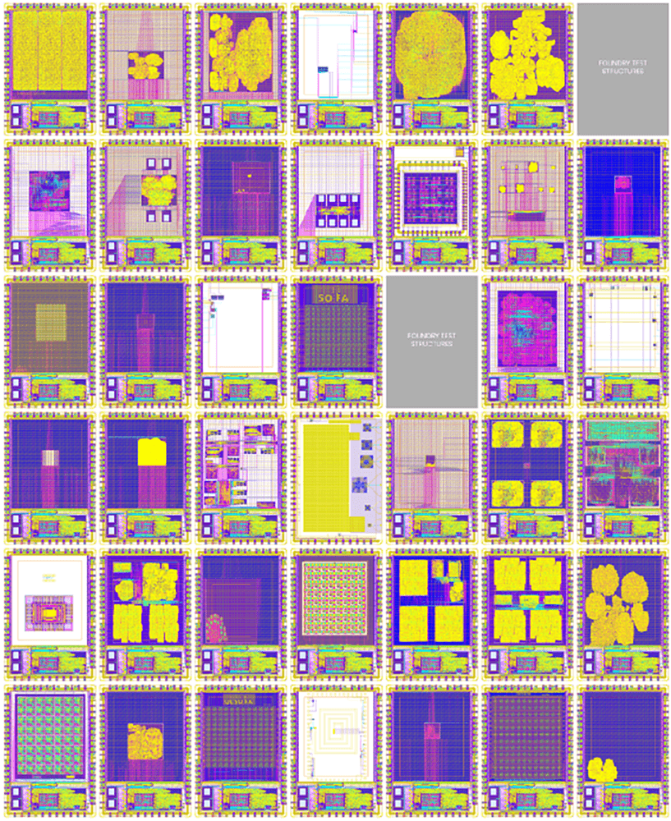
Overview
Implementation
[4]
What is hardening?
Provides compilation, synthesis, place and route, and signoff all in one package
Generates hardened macros for submodules AND hardened top-level design
Different implementation techniques
Behavioral Verilog
Custom Cell
SRAM
pp. 40-45
Notes:
TODO: incorporate this into one slide describing normal costs and why this being free is good for groups like ourselves?
Will
The efbaless open MPW shuttle program is funded by google. Thie means that there is no cost for us to participate in the program. We are able to submit our project without an submission cost. We will eventually get back a handful of our chips back for free after like a year.
There is also no cost associated with the tools as the whole project is meant to be open source. This means that the tools are supported by members of the open source community and are free to us
For now we are using a gitlab instance that was offered to us by the department but one prerequisite for submission is that we host our project in a public repo on github
With every major part of the project having no cost associated with it the only real cost being our time investment into the project

Slide 20
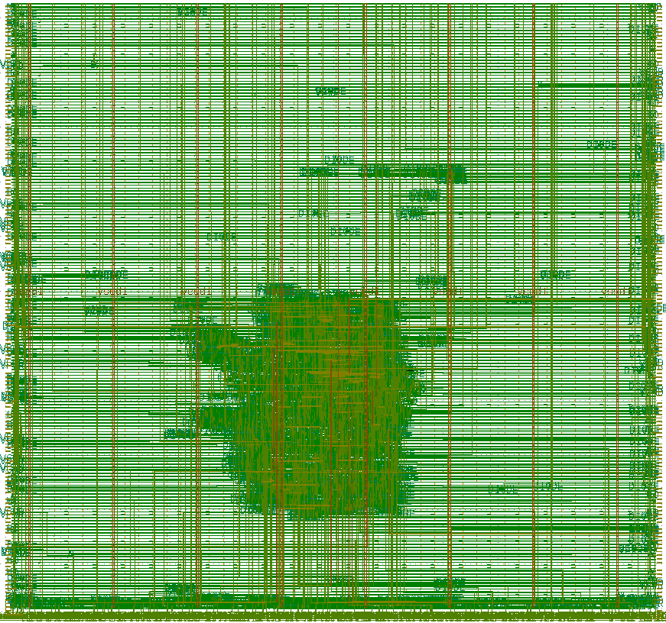
Behavioral RTL
Implementation
Define functionality of modules using Verilog
"Common Case" for most designs
Can be utilized for full design process
Used for:
Standard Cell Test
Backdoor SPI
Wishbone Bus Test
DSP Accelerator
Custom Cell (functional verification only)
Clock MUX (functional verification only)
pp. 40-43

Slide 21
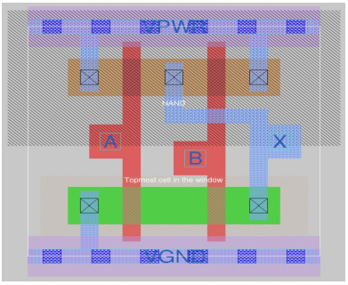
Custom Cell
Implementation
Create custom cell for use in parallel with SkyWater 130nm PDK
Utilize open-source tools and new process for team and users
Used for:
Custom Cell (GL verification, hardening)
Unique Process:
Magic
XSchem
pp. 40-41

Slide 22
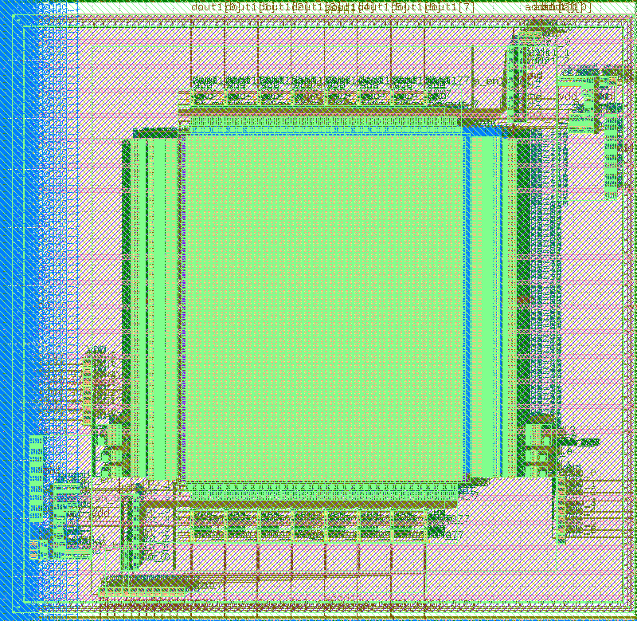
SRAM
Implementation
Utilizes OpenRAM project for SkyWater 130nm fabrication process
Requirement:
Had to be placed in top level wrapper
Used for:
DSP Accelerator (GL verification, hardening)
Unique Process:
OpenRAM
pp. 42-43
Notes:
Will
The efbaless open MPW shuttle program is funded by google. Thie means that there is no cost for us to participate in the program. We are able to submit our project without an submission cost. We will eventually get back a handful of our chips back for free after like a year.
There is also no cost associated with the tools as the whole project is meant to be open source. This means that the tools are supported by members of the open source community and are free to us
For now we are using a gitlab instance that was offered to us by the department but one prerequisite for submission is that we host our project in a public repo on github
With every major part of the project having no cost associated with it the only real cost being our time investment into the project

Slide 23
Project Deliverables
Functional Design
Precheck Pass
Caravel User Guide
Bring-Up Plan
Cade Breeding

Slide 24
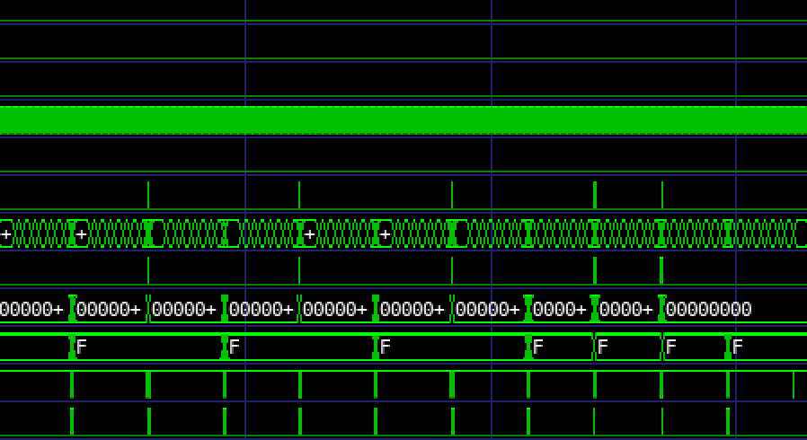
Deliverable 1 – Functional Design
Project Deliverables
What was utilized?
Modular Verilog designs
Custom NAND cell
Pre-hardened blackbox designs
Validated submodule and top-level designs
RTL Verification
GL Verification
C Testing
pp. 88 - 95

Slide 25
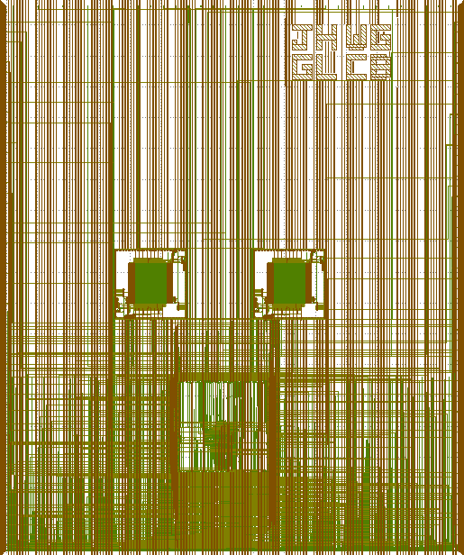
Deliverable 1 – Precheck Pass
Project Deliverables
Client Request
Product passes the required precheck for MPW submission
Perform signoff with SDF simulations
Delivered Product
Precheck passes the required tests for submission
Contents of Product
Screenshots and code repository proving precheck pass
pp. 43 - 45

Slide 26
Deliverable 2 – Caravel User Guide
Project Deliverables
Client Request
Document implementation processes including behavioral RTL, custom cell, and SRAM
Document testing process for RTL, GL, SDF, and C testing
Delivered Product
Detailed instruction manual with referenced implementation and verification processes
Contents of Product
Appendix 8.4.1
pp. 53 - 70
Notes:
Expand Client Request
Looked at open soure projects and found that many were not properly implementing sram

Slide 27
Deliverable 3 – Bring-Up Plan
Project Deliverables
Client Request
Plan that future groups can use to verify functionality of manufactured design
Delivered Product
Bring up plan that will comprehensively test our design to ensure viability
Contents of Product
C tests that can be run on the management soc to verify the device
Written plan with the startup procedure
pp. 71 - 75

Slide 28
Conclusion
Challenges
Future Work
Final Summary
Cade Breeding

Slide 29
Potential Risks Identified in Semester 1
Conclusion
No OpenMPW submission is available
DSP module cannot both fit in user area and run at real time – Success
Wishbone bus is unable to interact with user modules after fabrication
Fabrication error causes an individual module to fail
pp. 24-25
Notes:
We have identified some potential risks that could prevent our project from being a complete success
The first is that there may not be an Open MPW that is taking submissions around the time when we have completed the project.
We will mitigate this by ensuring that our project is completely ready for submission and can turned in either by a future team or by Dr. Duwe
The next risk that we identified was that the Voice Road Noise Isolation Module would not be able to fit in the user area and run in real time
We have tried to mitigate this risk by _______
We then identified a risk with the wishbone bus not being able to interact with the modules inside of the chip.
We mitigated this risk by introducing the backdoor SPI module that would allow us to still communicate with the modules even if their was a failure with the wishbone bus
Lastly we have a risk of individual modules incurring a failure.
We have mitigated this risk by pursuing a modularized approach that will test many different functionalities of the process and the project can still gain valuable data without all of the modules functioning.

Slide 30
Challenges
Conclusion
LVS problems during hardening
Updating the PDK version
Open-source tools come with their own challenges and behave differently then propriety tools.
Precheck DRC issues with the custom cell
SDF Simulations are extremely slow

Slide 31
Future Work
Conclusion
The next step is to submit to the MPW9 shuttle and receive our fabricated design
Future testing groups can utilize our Bring-Up Plan deliverable and module specifications to validate our fabricated design.
Future senior design teams can utilize our Caravel User Guide deliverable to design more complex designs at a faster rate.

Slide 32
Final Summary
Conclusion
Design:
Functional requirements met
Precheck passed
Ready for MPW submission and fabrication
Knowledge:
Created bring up plan documentation
Create user guide documentation
Solved new and existing issues with design processes (Custom cell, SRAM)
pp. 51
Notes:
ADD Villiger face and Preche

Slide 33
References
Conclusion
^{[1]} https://www.pngall.com/microcontroller-png/
^{[2]} https://efabless.com/open_shuttle_program
^{[3]} https://www.zerotoasiccourse.com/post/mpw1-bringup/
^{[4]} https://efabless.com/open_shuttle_program
pp. 52
Notes:
TODO: update as necessary

Slide 34
Questions?

Slide 35
Supplemental Material

Slide 36
Constraints
Supplemental
[4]
eFabless
10 mm² user area
SkyWater 130 nm fabrication process
Verilog
Specific folder structure
MPW Precheck
Open-source repository
pp. 16-19

Slide 37
Backdoor SPI Module
Supplemental
pp. 100
Notes:
The Backdoor SPI module is a custom external SPI interface to the internal modules that does not require the management microcontroller
It will allow direct communication with modules from outside of the chip to ensure that we are able to externally communicate with the chip.
One of the major design challenges is to clock domain crossing between the external clock domain and our system clock

Slide 38
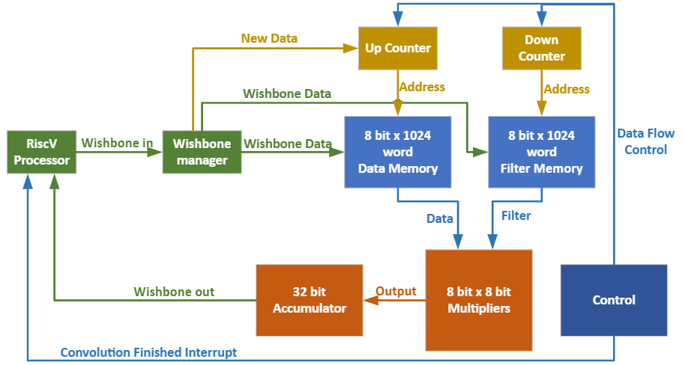
Voice Road Noise Isolation Accelerator Module (DSP)
Supplemental
pp. 83

Slide 39
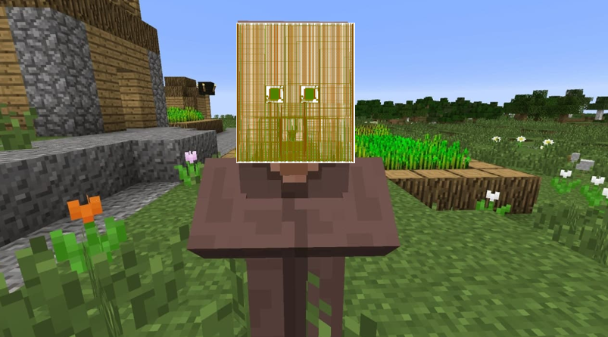
Supplemental
Notes:
TODO: verify correctness of diagram

Slide 40
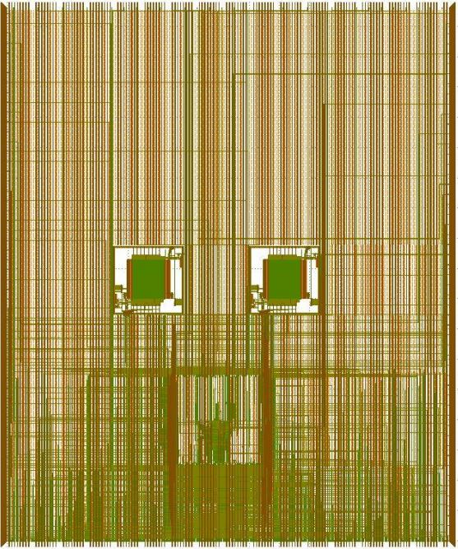
Does our design look like a Minecraft villager?
Supplemental
https://www.minecraft.net/en-us
Notes:
TODO: verify correctness of diagram

