Slide 1
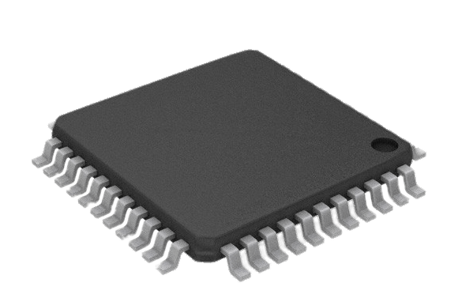
Digital ASIC Design Faculty Panel Presentation
[1]
Gregory Ling
Will Galles
Jake Hafele
Cade Breeding
Class: CPR E 491
Group: sddec23-06
Client/Advisor: Dr. Duwe
Website: http://sddec23-06.sd.ece.iastate.edu/
Notes:
https://www.pngall.com/microcontroller-png/

Slide 2
Introduction
Overview
Users
Requirements
Constraints
Market Survey
Gregory Ling

Slide 3
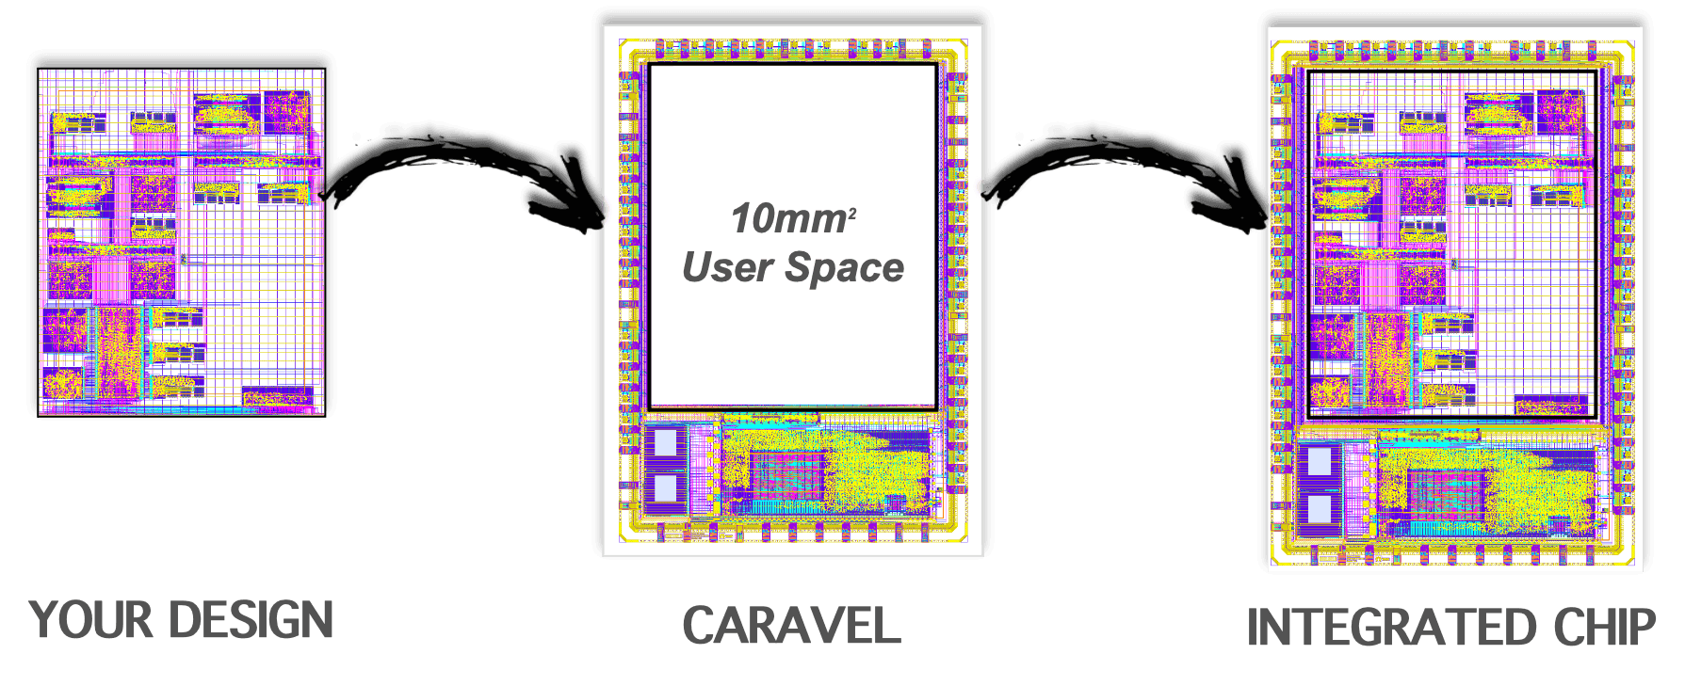
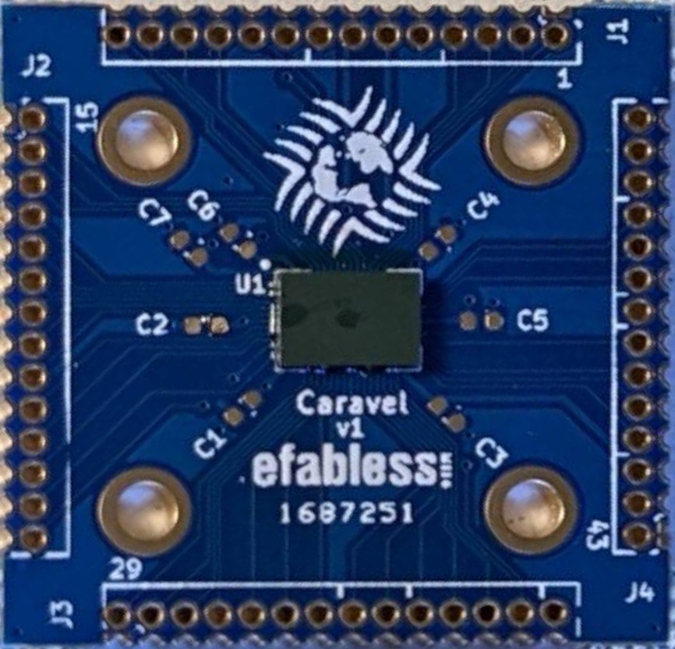
Overview
Introduction
[2]
ASIC Design
OpenMPW (eFabless)
Open Source
[3]
p. 13
Notes:
The ability to create a custom digital ASIC (Application Specific Integrated Circuit) is often locked behind high barriers to entry and restricted to industry professionals. eFabless has provided a free fabrication option named OpenMPW with the requirement that all submissions be open-source, and we will test their manufacturing process and determine its limits. What we learn will be passed down to future users who will use our design as a reference in creating their own for research or other learning tasks.

Slide 4
Engineering Standards
Introduction
IEEE 1364-2005 – IEEE Standard Verilog Hardware Description Language
ISO/IEC 9899:2018 – C programming language (C17)
TIA/EIA 232-F – RS232 (UART) Protocol
Serial Peripheral Interface (SPI) Protocol
Wishbone Bus
Inter-Integrated Circuit (I2C) Protocol
p. 15

Slide 5
Users
Introduction
Our Team
Research
Groups
Future Teams
Open Source
Community
p. 16

Slide 6
Requirements
Introduction
Explore
Modular design to test different limits of the fabrication process
Learn
Challenge ourselves to work in new areas
Bring-Up Plan
Create a plan for a future group to test our design
p. 13
Notes:
…

Slide 7
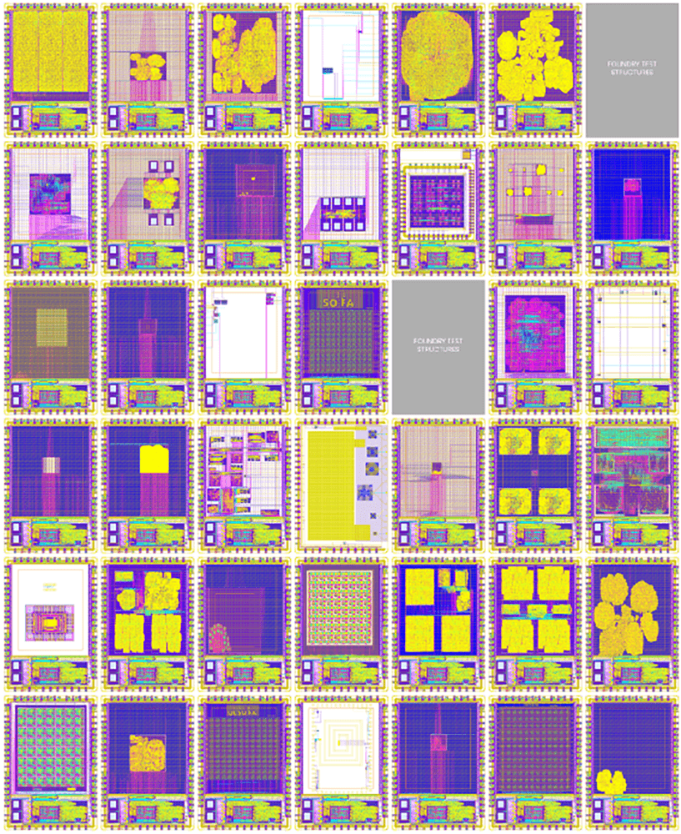
Constraints
Introduction
[4]
eFabless
10 mm² user area
SkyWater 130 nm fabrication process
Verilog
Specific folder structure
MPW Precheck
Open-source repository
pp. 13-15

Slide 8
Market Survey
Introduction
Production Run
~$1M for full ASIC
Multi-Project Wafer
OpenMPW – eFabless, open-source, funded by Google
ChipIgnite – eFabless, paid ($9,750/project, 10mm², 4-5 months)
Muse Semiconductor – TSMC, paid ($1,250/mm², 42 days)
p. 17
Notes:
Muse lacks tool support

Slide 9
Design
Functional Modules
Top Level Design
Potential Risks
Resource Cost Estimate
Will Galles

Slide 10
Module Overview
Design
Wishbone Test
Gregory Ling
Clock Gating
Cade Breeding
Backdoor SPI
Jake Hafele
Custom Cell Test
Gregory Ling
Standard Cell Test
Cade Breeding
Voice Road-Noise Isolation
Will Galles
pp. 49-54

Slide 11
Backdoor SPI Module
Design
pp. 61-72
Notes:
The Backdoor SPI module is a custom external SPI interface to the internal modules that does not require the management microcontroller
It will allow direct communication with modules from outside of the chip to ensure that we are able to externally communicate with the chip.
One of the major design challenges is to clock domain crossing between the external clock domain and our system clock

Slide 12
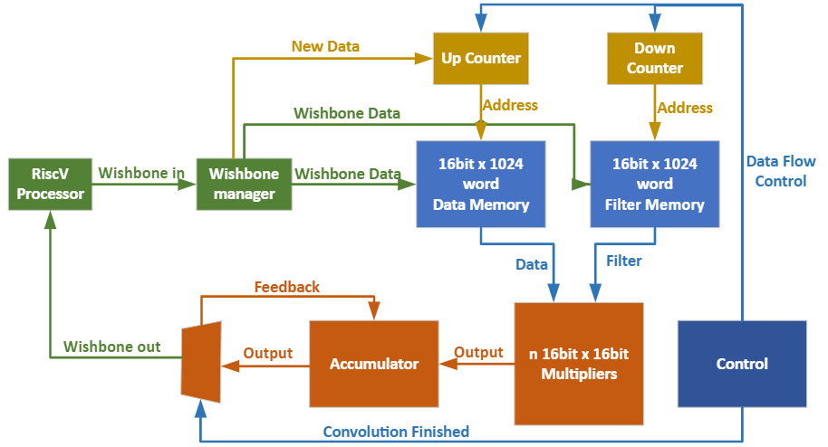
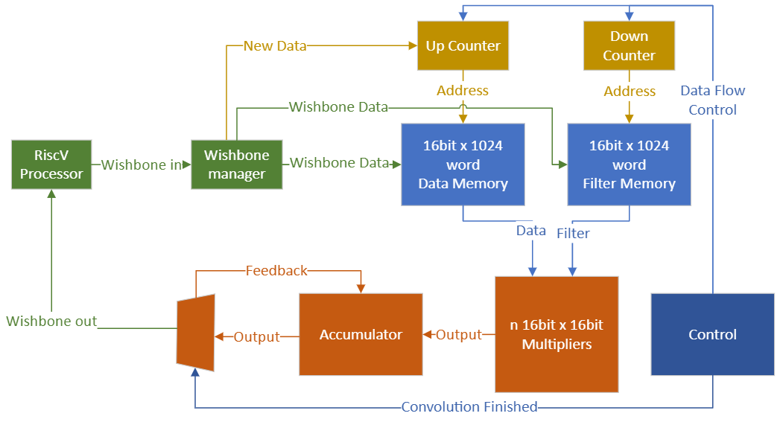
Voice Road Noise Isolation Module (DSP)
Design
pp. 50-52
Notes:
The Voice Road Noise Isolation module uses a Weiner frequency filter to isolate voice from automotive noise.
This is specifically to test a dense application which will use a large number of gates in the RAM and multiplies.
The purpose of the Voice Road Noise Isolation module is to enhance voice audio from a noisy automotive environment.
The module accomplishes this by implementing a Weiner Filter.
A Weiner Filter is a frequency filter that is carefully crafted to reject frequencies that do not correspond with the human voice.
This module takes in a continuous stream of noisy voice data from an audio source such as a microphone in a car.
It then preforms a convolution with previously generated Weiner Filter.
This convolution applies the filter to noisy audio and the output is a cleaned version of the voice.
This module is primarily there to test how dense we are able to pack the user area.
It will accomplish this because it will require a large amount of multipliers in the convolution unit to be able to process the incoming audio in real time.
We will be able to test how many gates that we can really fit into the user area.

Slide 13
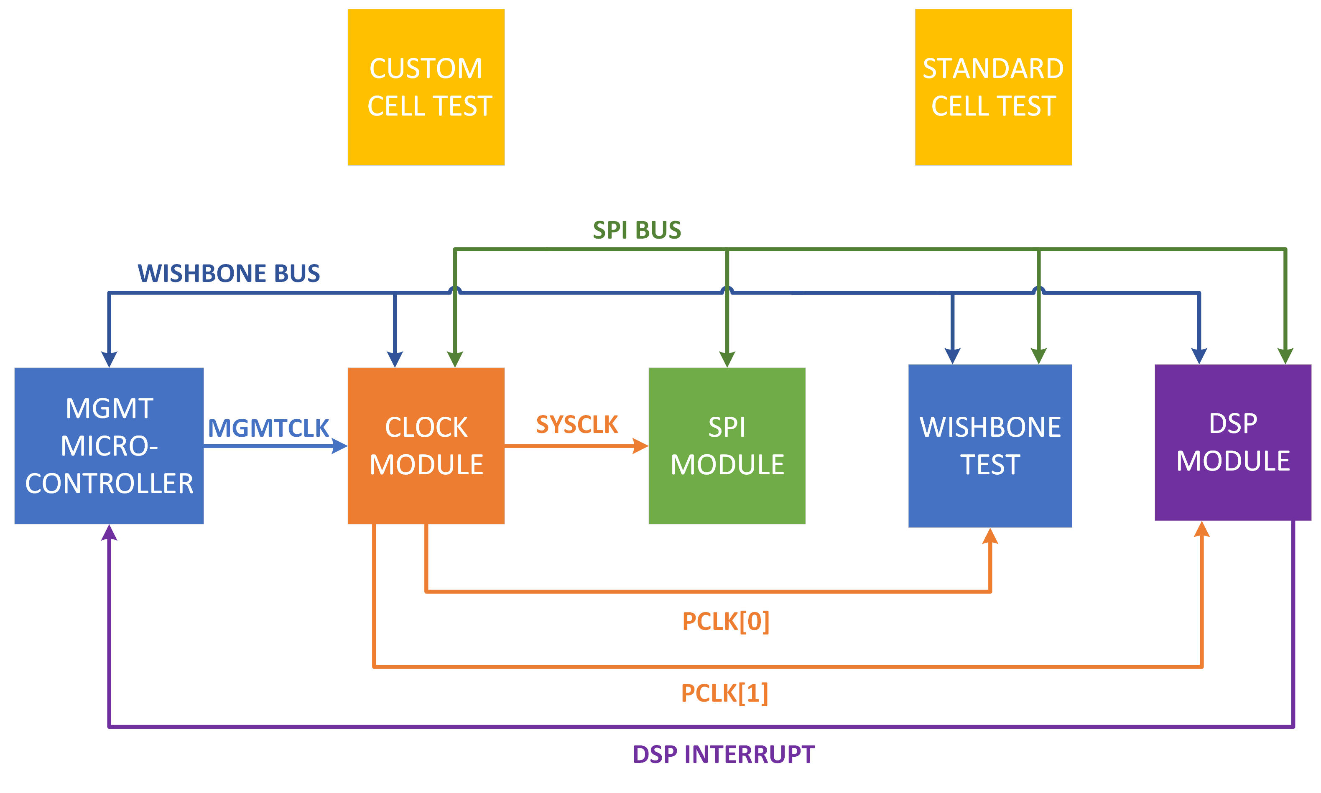
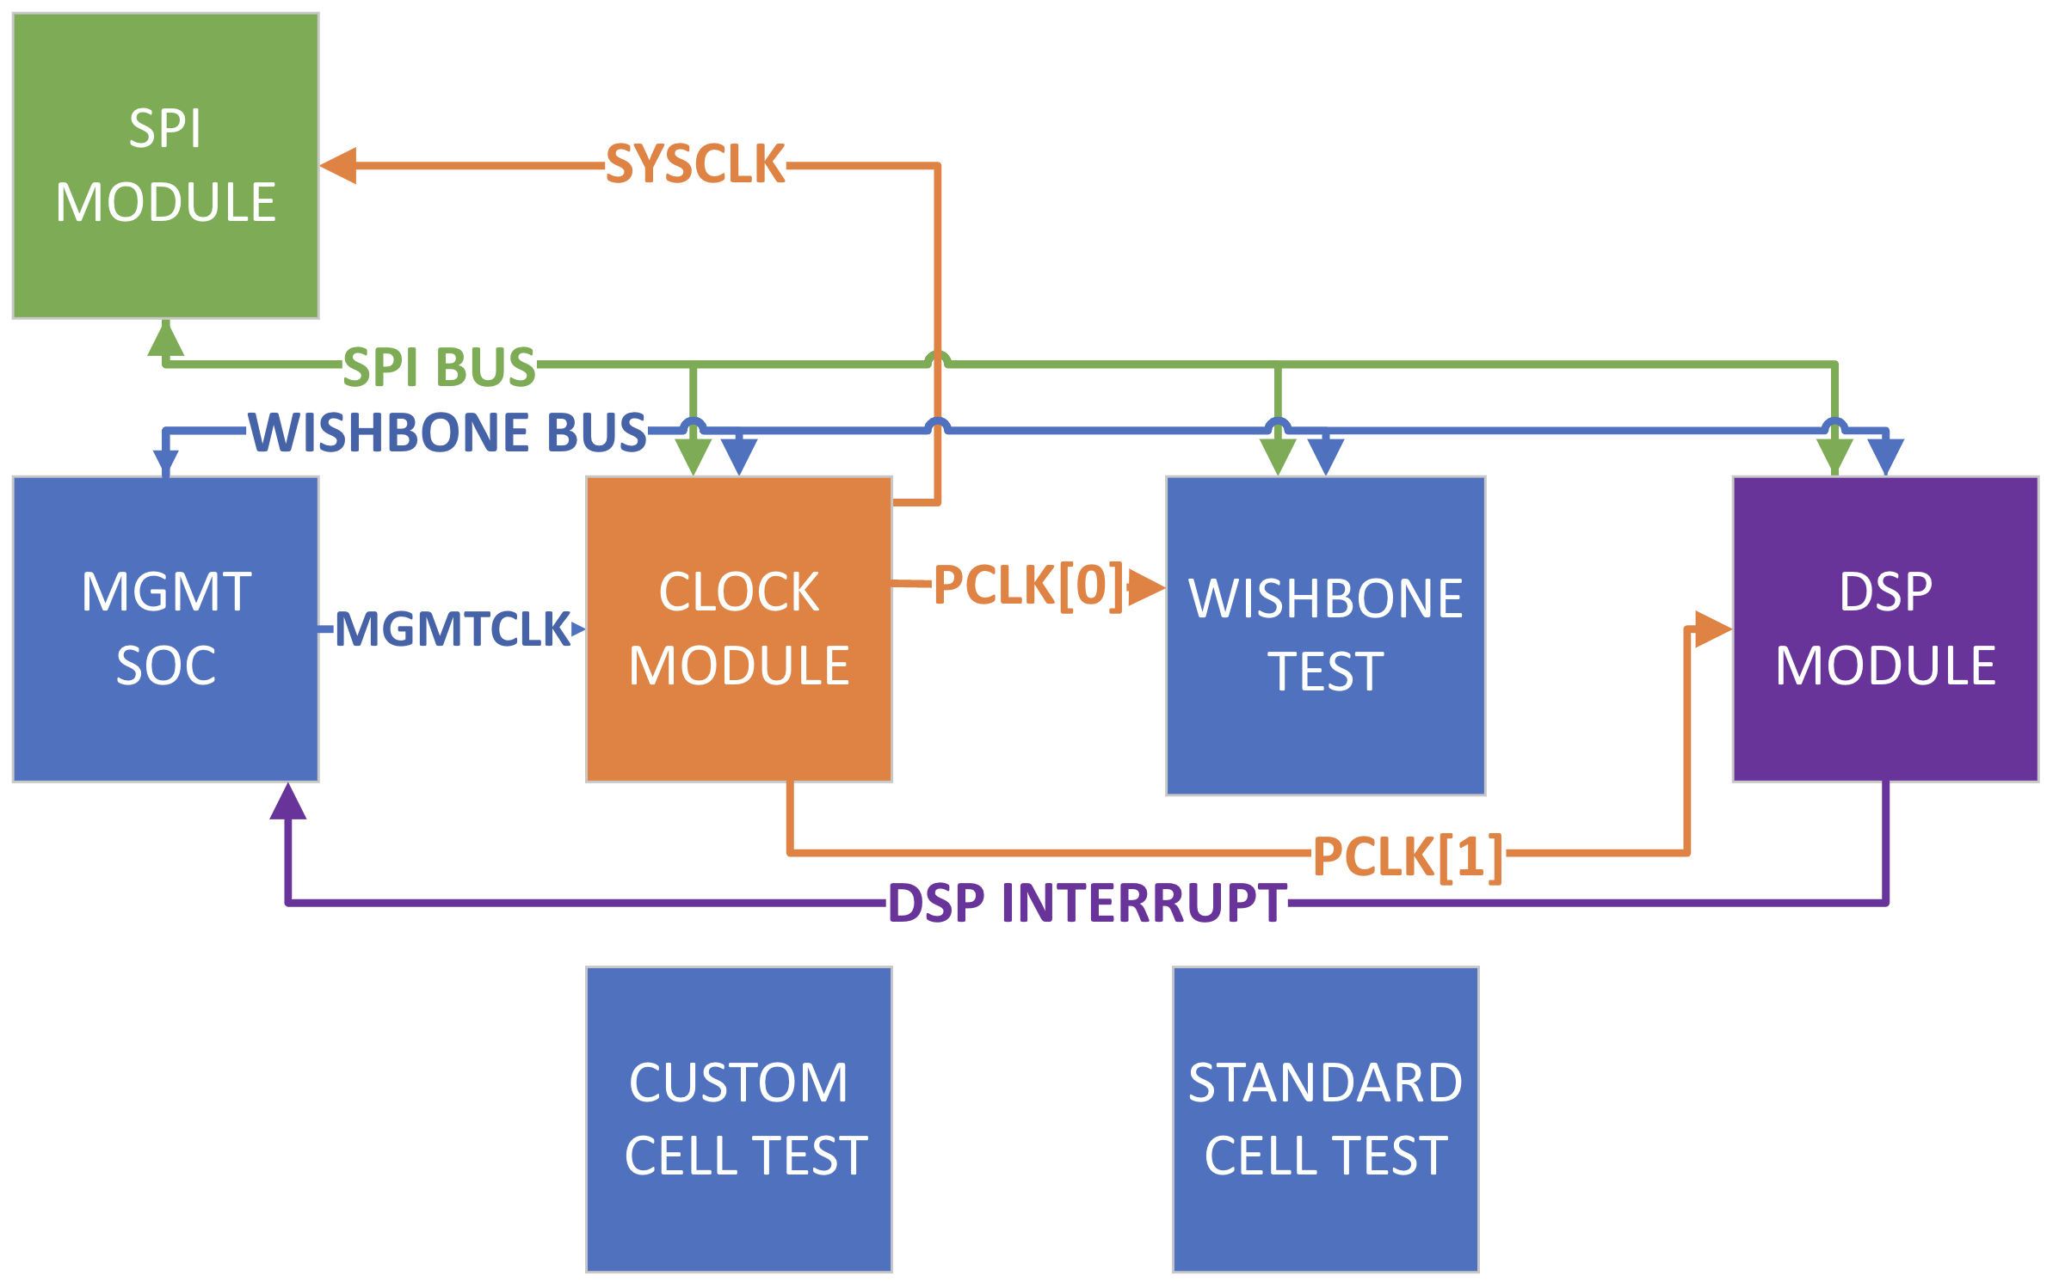
Top Level Design
Design
pp. 29-31
Notes:
This is our modular design with a handful of modules to test different capabilities of the efabless process.
We wanted to test many different aspects of the process all on a single chip, and the modular design builds in a redundancy in case parts of the chip fail to manufacture properly.
For redundancy, we will implement two separate communication busses that are connected to the modules, allowing us to use both the management microcontroller or an external SPI bus to test and control the modules in case one fails

Slide 14
Potential Risks
Design
​Risk ​ | Probability
​No OpenMPW submission is available ​ | ~​40% ​
​DSP module cannot both fit in user area and run at real time ​ | ~​40% ​
​Wishbone bus is unable to interact with user modules after fabrication ​ | ~​5%​
​Fabrication error causes an individual module to fail ​ | ~​15% ​
pp. 21-22
Notes:
We have identified some potential risks that could prevent our project from being a complete success
The first is that there may not be an Open MPW that is taking submissions around the time when we have completed the project.
We will mitigate this by ensuring that our project is completely ready for submission and can turned in either by a future team or by Dr. Duwe
The next risk that we identified was that the Voice Road Noise Isolation Module would not be able to fit in the user area and run in real time
We have tried to mitigate this risk by _______
We then identified a risk with the wishbone bus not being able to interact with the modules inside of the chip.
We mitigated this risk by introducing the backdoor SPI module that would allow us to still communicate with the modules even if their was a failure with the wishbone bus
Lastly we have a risk of individual modules incurring a failure.
We have mitigated this risk by pursuing a modularized approach that will test many different functionalities of the process and the project can still gain valuable data without all of the modules functioning.

Slide 15
Resource Cost Estimate
Design
Only real cost of the project is our time
eFabless Open MPW Shuttle program funded by Google
All design tools are open source
GitLab and Microsoft Teams provided by the ECpE department
p. 23
Notes:
Will
The efbaless open MPW shuttle program is funded by google. Thie means that there is no cost for us to participate in the program. We are able to submit our project without an submission cost. We will eventually get back a handful of our chips back for free after like a year.
There is also no cost associated with the tools as the whole project is meant to be open source. This means that the tools are supported by members of the open source community and are free to us
For now we are using a gitlab instance that was offered to us by the department but one prerequisite for submission is that we host our project in a public repo on github
With every major part of the project having no cost associated with it the only real cost being our time investment into the project

Slide 16
Testing
Platforms Used
Test Plan
Testing Thus Far
Jake Hafele
Notes:
Platforms Used
Test Plan
Testing Thus Far

Slide 17
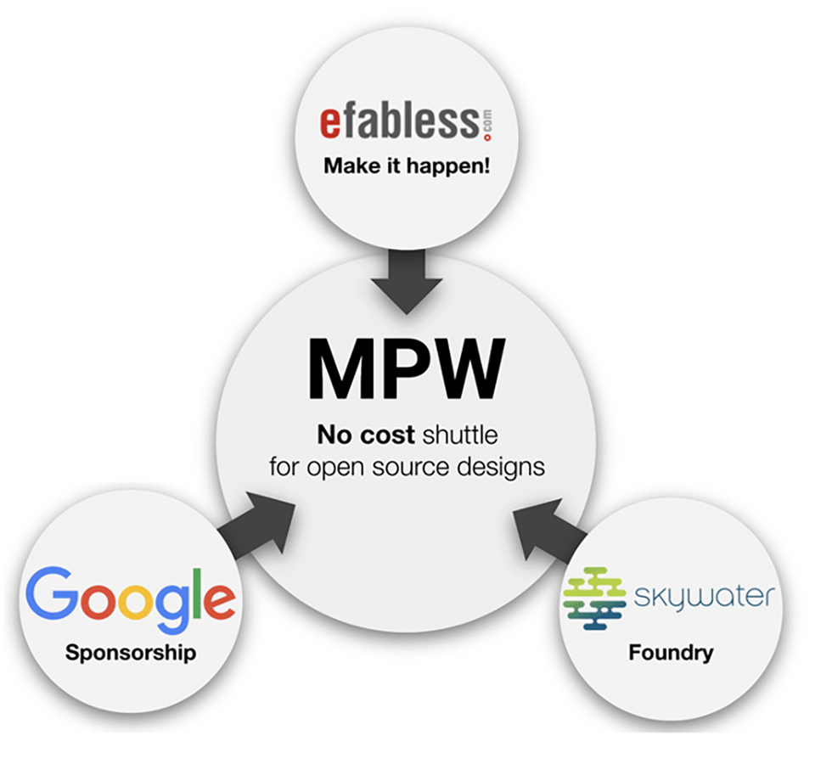
Platforms Used
Testing
OpenROAD
RTL synthesis through GDS Layout
Magic
Custom cell layout
KLayout
Layout viewer
GTKWave
Waveform viewer
[4]
p. 23
Notes:
As gregory mentioned before, there are no financial costs for our project.
Open Source Tools:
OpenROAD
Used for module hardening and system integration
Uses RTL design and SkyWater 130 nm Product Development Kit to generate GDSII netlist
Standard cell process for layout
Place and route
Magic
VLSI Layout tool
Used for custom cell layout
KLayout
Layout viewer from OpenROAD generation
GTKWave
View RTL and GL waveform outputs
Used for unit testing and system integration

Slide 18
Test Plan
Testing
Unit/Regression Testing
Integration Testing
RTL Simulations
Gate Level
Simulations
C Firmware
Simulations
Interface Testing
Bring-Up Plan
Acceptance Testing
Firmware Testing
Document Test Plan
MPW Precheck
pp. 32-34
Notes:
Unit Testing/Regression Testing
RTL Simulations
Verilog testbenches
Instantiate tested modules directly
Generates waveform output to be viewed with GTKWave
Gate Level simulation
Instantiate module through project wrapper
"Harden" unit under test using OpenROAD
Regression Testing
Rerun unit tests if module changed after bugs found in integration
Can use and update our RTL and GL simulations with original verification
Integration Testing
Interface Testing
Wishbone Bus
Backdoor SPI
Ensure each module able to send and receive data with BOTH bus protocols
System Testing
Test all modules together in combined project wrapper
Simulate C Code (Very slow)
Acceptance Testing (eFabless Precheck)
cloned caravel repository includes prechecker by eFabless
Ensures file structure and modules would pass for fabrication
Precheck pass needed for MPW submission
Bring-up Plan
Test Plan
Write test plan for future design team
Communication bus interfaces, GPIO, information on MPW return
Firmware Testing
Describe firmware needed to interface communication busses
Describe GPIO needed to test each module

Slide 19
Testing Thus Far – Adder, Standard Cell
Testing
Adder Waveform Results
2x1 Standard Cell MUX Waveform Results
pp. 59-60
Notes:
Use GTKWave as waveform viewer
Adder Waveform
Adder provided by previous May 2023 senior design group 28
Testbench adds two inputs and writes back output into adder
Achieved the goal of running RTL simulation inside toolchain
Standard Cell MUX Waveform
Testing a SkyWater Standard Cell 2-1 MUX directly
3 input combinational circuit, 8 possible outputs
If S = 0, output A0. If S = 1, output A1
Simple test, but tests capabilities of a standard cell if other modules fail

Slide 20
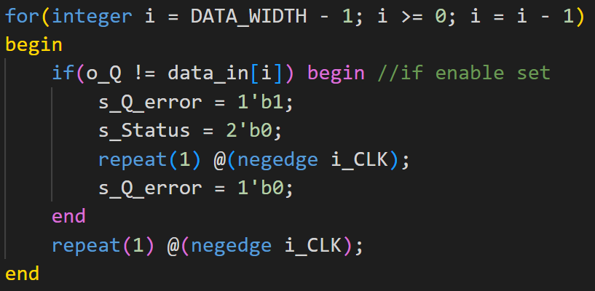
Testing Thus Far – Backdoor SPI, Shift Out Register
Testing
Shift Out Register Testbench Verification
Shift Out Register Waveform Results
pp. 55-59
Notes:
Shift Out Testbench
Tests the shift out register in the Backdoor SPI module
32 bit parallel in serial out shift register, shifting MSB first
Code snippet is verification of serial shift output
Uses a for loop to check every bit as it is shifted against the input variable shift_in to the task
Can apply error checking for robust unit testing and an accessible bring up plan
Shift Out Waveform
Sample of hex value 0x64 loaded in
32 bit serial shift out begins after i_START is asserted
o_Q is serial output, checked against input of shift out verilog task
If there is a mismatch on a bit, the Q error flag is raised for one clock cycle
If any test fails, the s_Status signal drops to 0

Slide 21
Future Implementation
Milestones
Schedule
Plan for the Future
Cade Breeding

Slide 22
Milestones and Schedule
Future Implementation
p. 21
Notes:
Here is how we broke down our tasks and planned them out for this semester and the next. Very quick summary of the completed and in progress milestones (go more in depth on the current status in the conclusion).

Slide 23
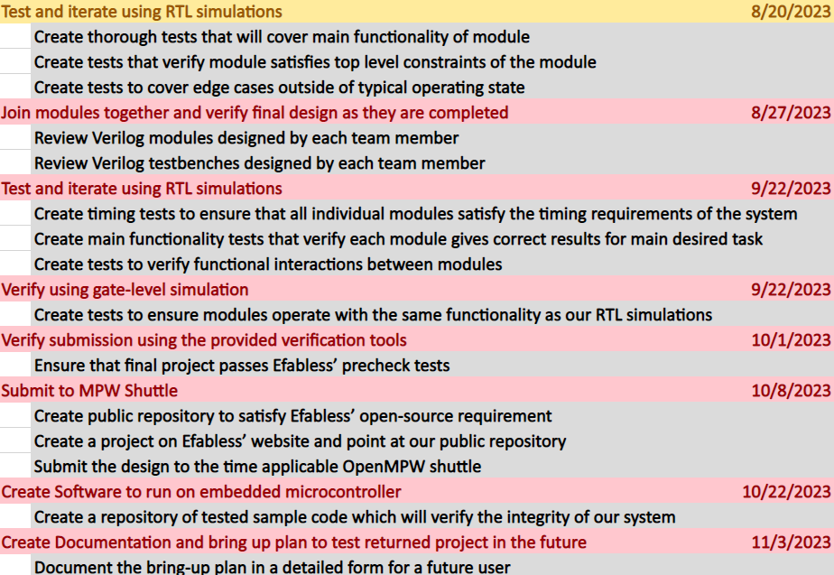
Next Steps
Future Implementation
RTL Simulation
Integration of Modules
RTL Simulation
Gate Level Simulation
Verification
Submission
Bring Up Plan
p. 21
Notes:
Describe each of the steps that are listed. Testing, Submission and Open Source process, Bring up Plan

Slide 24
Conclusion
Current Status
Contributions
Cade Breeding

Slide 25
Current Status
Conclusion
Wishbone Test
Gregory Ling
Verilog Started
Clock Gating
Cade Breeding
Verilog Started
Backdoor SPI
Jake Hafele
In Testing
Custom Cell Test
Gregory Ling
Exploration
Standard Cell Test
Cade Breeding
Verilog Started
VRNI (DSP)
Will Galles
Verilog Starting
p. 43

Slide 26
References
Conclusion
^{[1]} https://www.pngall.com/microcontroller-png/
^{[2]} https://efabless.com/open_shuttle_program
^{[3]} https://www.zerotoasiccourse.com/post/mpw1-bringup/
^{[4]} https://efabless.com/open_shuttle_program
p. 44

Slide 27
Questions?

